Slide 1




FindMyHostel
Find Your Ideal Off-Campus Hostel On Your Finger tip
Overview
Process
Conclusion
Demo
Overview
In-Brief
Traditional system
Proposed System: FindMyHostel
Stages
Ideation phase
Planning phase
Requirement Gathering and Analysis
Designing phase
Implementation Phase
Conclusion
Outlining its Importance
Call to action
Demo
Registering & Logging in
Searching & Filtering
Booking Room
Hostel Owner
Super Admin

Slide 2
Overview
We're a student-focused platform connecting University students with affordable and comfortable off-campus hostel options.
Traditional System
Tiresome
Time Costly
Hostel Info not readily available
Proposed System (FindMyHostel)
Fast
Offers a centralised comparison platform
Readlyn available hostel info
FindMyHostel Users
Students
Super Admin
Hostel Owners

Slide 3
Development Stages
1
2
Planning
Requirement Gathering & Analysis
Planning
Feasibility study
Charter
Req Gathering Interview
Observation
Functional Req
User Registration & Login
Searching and Filtering
User Profile Management
Hostel Management
Room Booking
Non-Functional Req
user-friendly interface
High performance
security

Slide 4
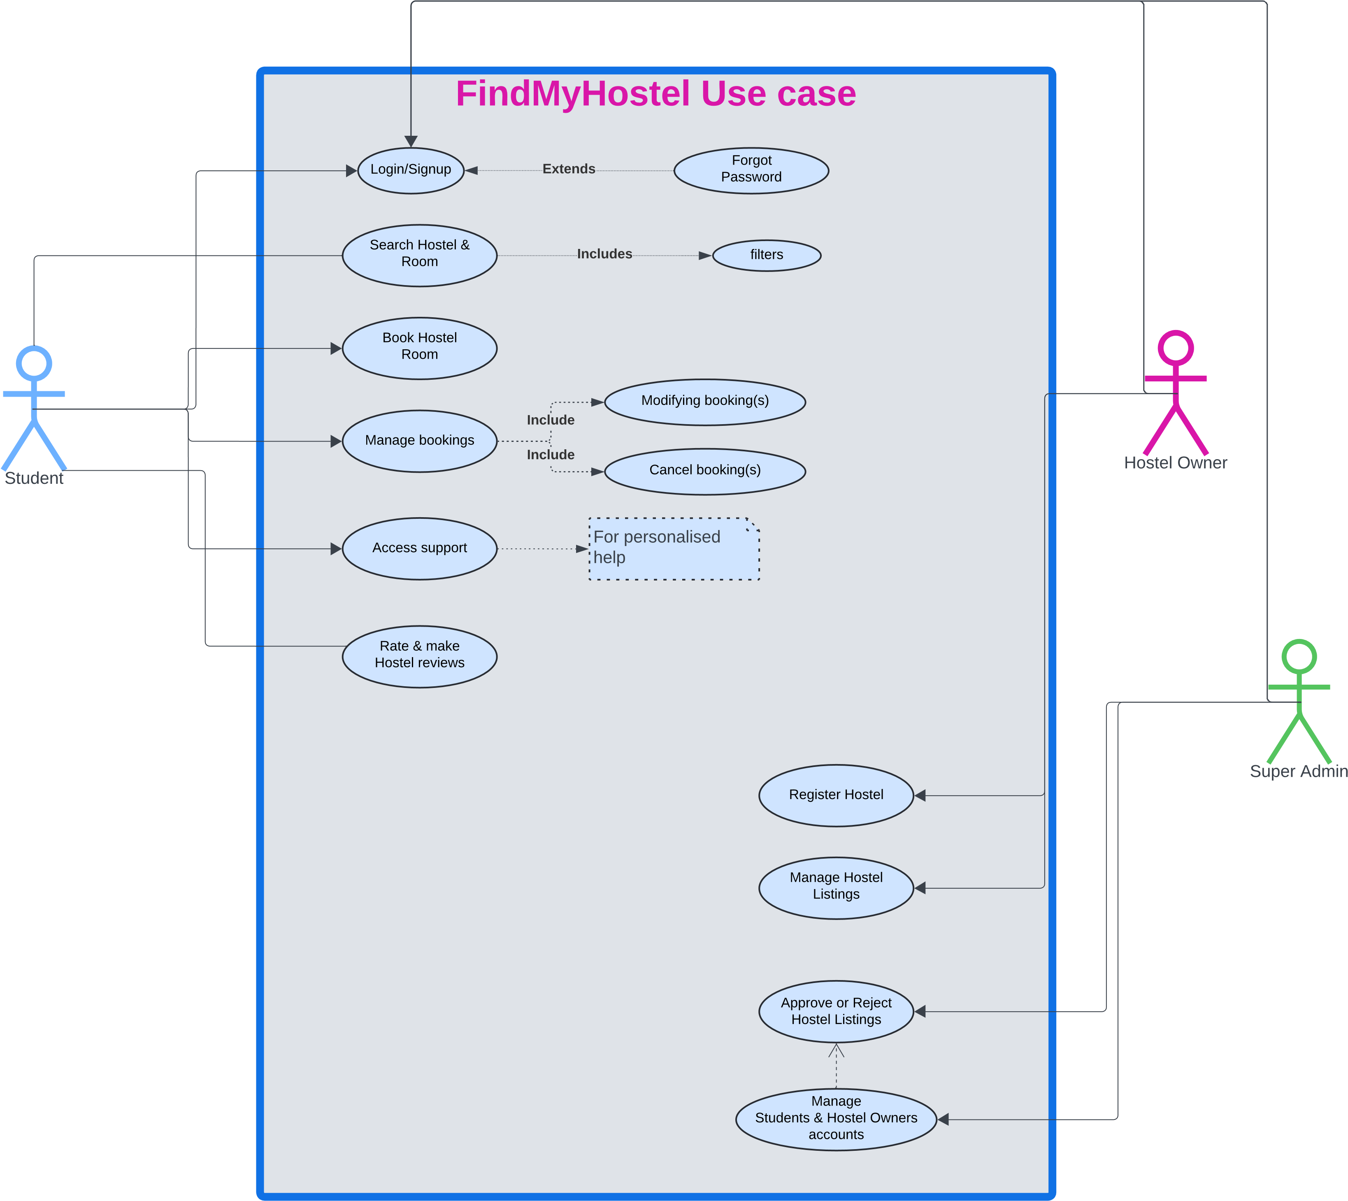
3
Designing

Slide 5
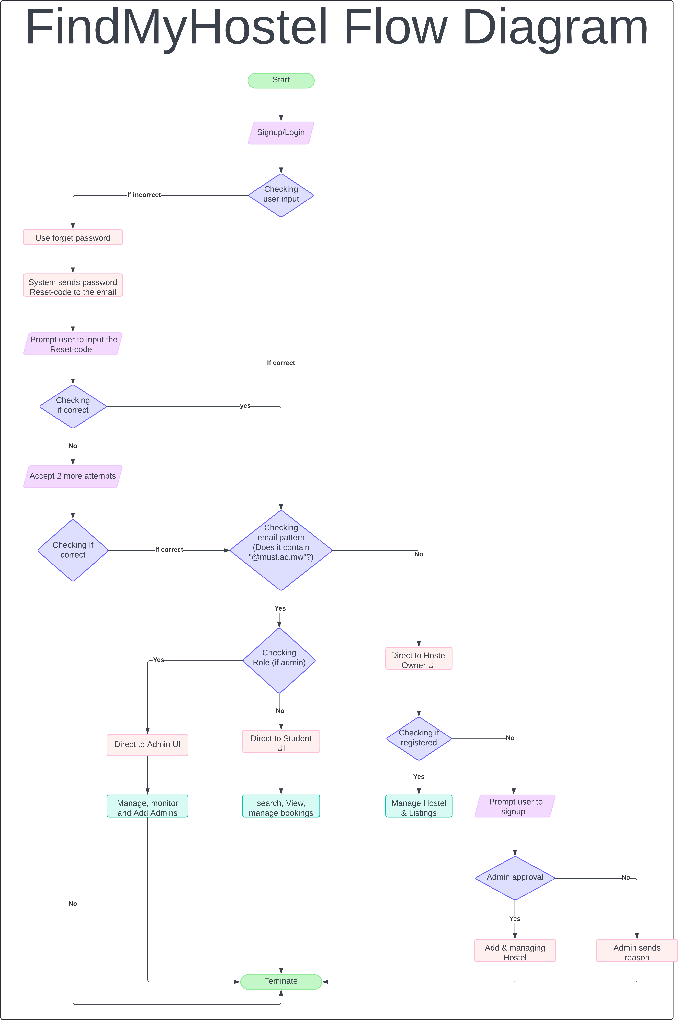
3
Designing

Slide 6
5
6
Implementation
Conclusion
Implementation of the figma designs
Testing:
Integration
Security
Unit
Project Outcome: A functional, user-friendly hostel booking platform.
Key Skills Developed:
Project planning,
team collaboration
quality assurance.
Next Steps: Final refinements
GITHUB LINK: https://github.com/HAMID-JUMA/GROUP-7-FindMyHostel-Project.git

